Slide 1
Web Scraping Scripts Generator
Akhand Mishra
(15SCSE101052)

Slide 2
What is it?
A desktop application to write web scrapers.
Takes URL as input and gives Python script as output
Allows user to select which elements to scrape.

Slide 3
Why is it needed?
Data is gold in today’s world.
The largest source of data is the Web!
Scrapers make it easy to fetch data from the web.
This software makes it easy to write those scrapers.

Slide 4
An expert Data Scientist says:
“ Data Collection is an important step for research purposes, it helps in understanding the market precisely. ”
A freelance ML developer says:
“ The more the data varies, the more broader view it gives, the accurate the models get and hence we need a way to gather more data quickly. ”

Slide 6
Whom will it benefit?
Organisations that need to collect feedback on their product from different sources (such as Facebook, Twitter, Insta, LinkedIn).
Freelance Developers working on projects that require scraping different websites for data.
Any general script writer.

Slide 7
How will it benefit?
No need to write separate scripts for separate websites.
Works even if the website fetches data dynamically on load.
No knowledge of writing Python scripts required.
Defined functions to fetch Tables, Images and static files.

Slide 8
Key Features
Features to get all the Tables, Images, Links.
Save tables as CSV or in form of Python lists for further ML actions.
Fetch words, sentences and word frequencies.
Fetch only some specific element of the webpage.
Track any chanes on the website, get notified via Mail.

Slide 9
Prerequisites
Basic HTML knowledge

Slide 10
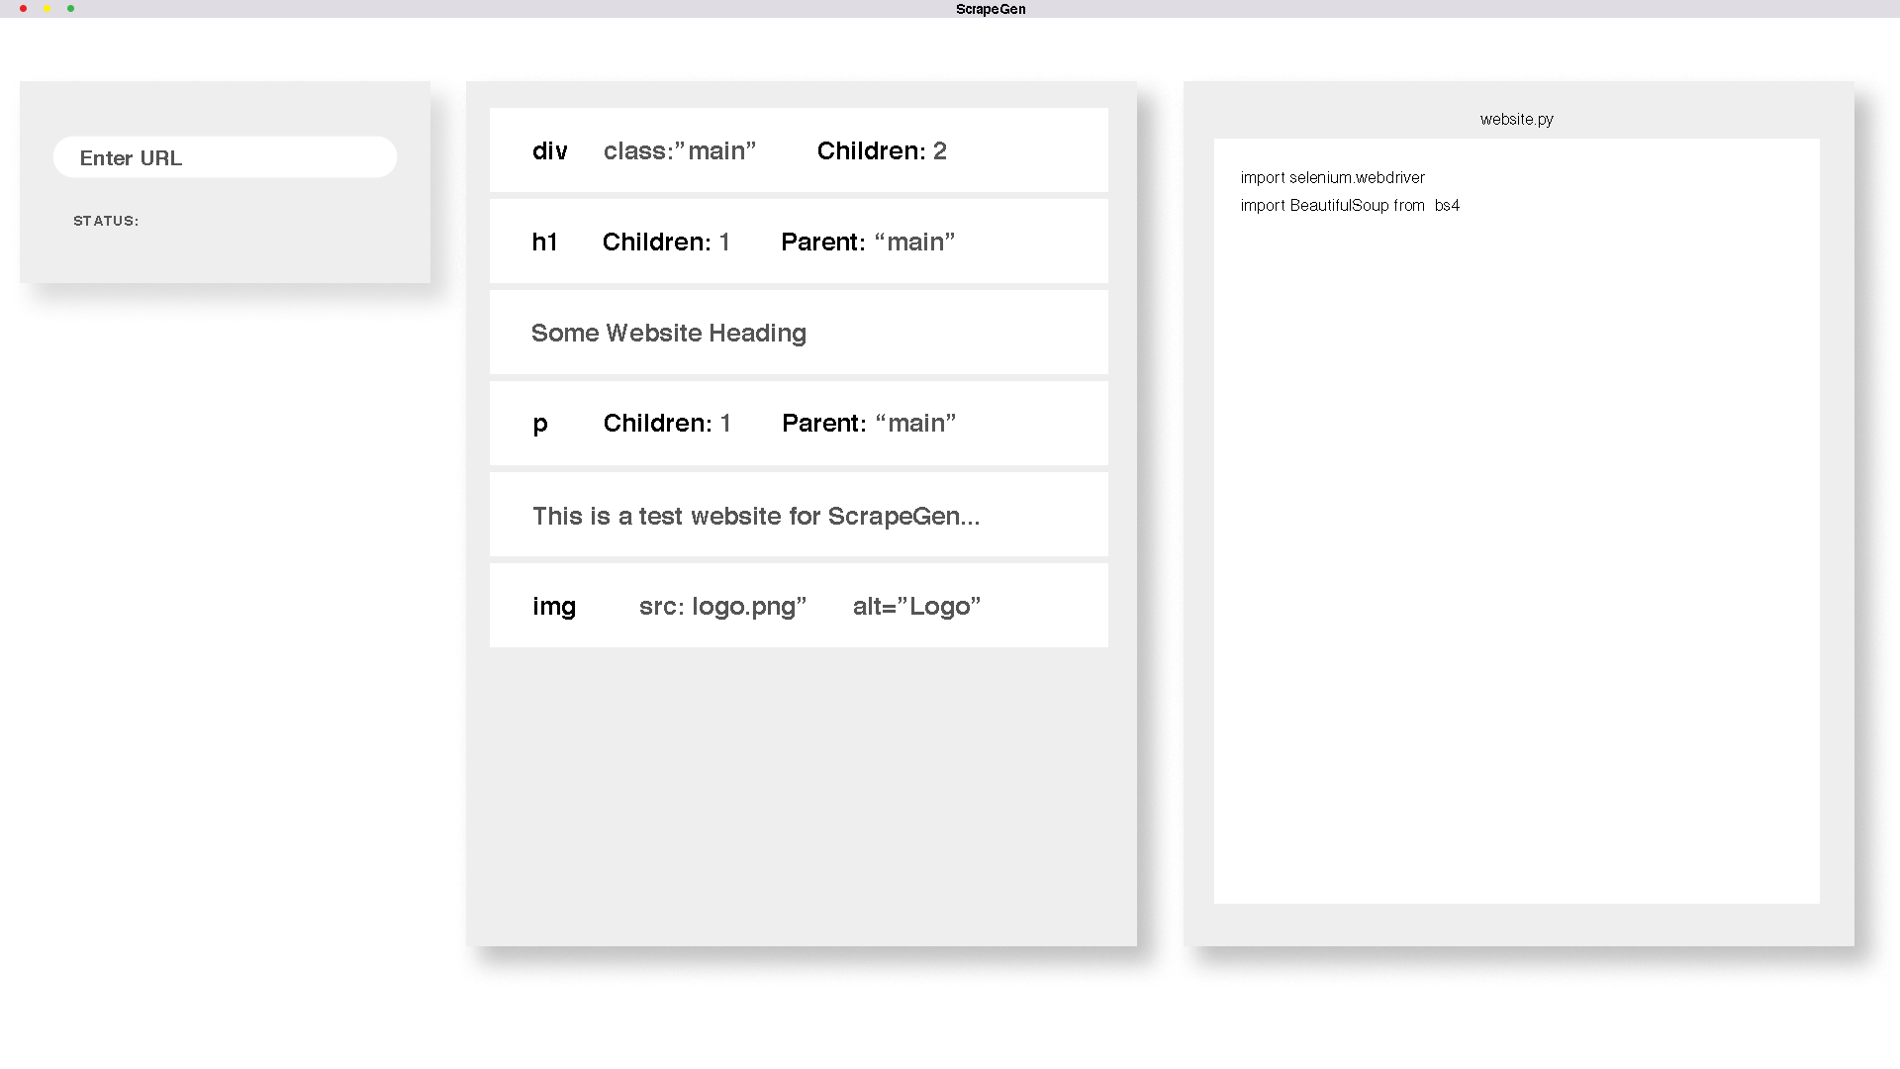
How to use?
GUI on load.

Slide 11
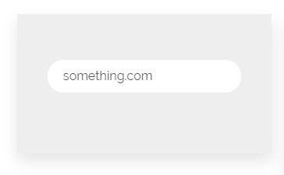
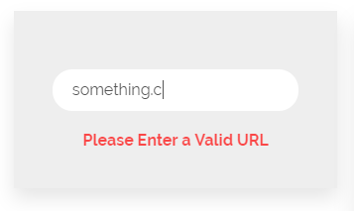
Enter the URL in the input box.
This box comes with embedded URL checker.

Slide 12
Web elements of the webpage will be shown on the Display Area.
Click on the element to generate script for it.
The scripts will be generated in the third element, i.e. a generation area.
The scripts generated will be in Python Language.
User can edit the scripts via the editor.

Slide 13
Software Perks
Cross Platform.
Embedded Python editor.
Buttons to select the web element.
Mordern GUI.
Premium plan allows user to track the website changes.

Slide 14
Revenue Model
Basic plan:
Basic plan is free.
Allow upto 5 scrapers per project.
No website tracking feature.
Premium plan:
Rs. 600 per month.
Unlimited scrapers.
Active website tracking using cloud.

Slide 15
Other products out there
All the other softwares out there are either focused on building survey forms or providing a platform to get feedback for your project.
Some of them are:
Device Magic
GoFormz
Nexticy

